Slide 1
Resources for teaching Mali, c.1235-1435

Slide 2
Enquiry
Enquiry: How can we describe state and society in Mali, c.1235-1435, based on the evidence available to us?
Method: We’re going to try to use a variety of evidence, including music, architecture, and written sources.
Explanation: This packet of materials is designed to give the teacher a wide variety of options for teaching the history and society of ‘medieval’ Mali. Depending how much time you have, you may choose any of several different pathways. Each section includes some free readings or other materials for teachers to build their knowledge or select sections for students, as well as some potential resources for use in class.

Slide 3
Written Sources

Slide 4
Background resources
Nehemia Levtzion, Ancient Ghana and Mali, New York and London: Africana Publishing, 1973, https://www.sahistory.org.za/sites/default/files/archive-files3/nehemia_levtzion_ancient_ghana_and_malibook4you.pdf .
Toby Green, History A, African Kingdoms: A guide to the Kingdoms of Songhay, Benin, Oyo and Dahomey, c.1400-c.1800, https://www.ocr.org.uk/Images/208299-african-kingdoms-ebook-.pdf .
The Ancient Civilization of Mali, A Teaching Unit for PK-6 Students, https://wmpeople.wm.edu/asset/index/gamcea/ancientmali .

Slide 5
Resources for using written sources
Begin with Toby Green’s presentation West Afrian History Before 1600 Mali Empire.pptx.
Library of Congress, “Islamic Manuscripts from Mali: Timbuktu – an Islamic Cultural Center. http://international.loc.gov/intldl/malihtml/islam.html .
Sites of Encounter in the Medieval World Lesson #4: Mali, California History Social Science Project, https://chssp.ucdavis.edu/programs/soe-4-mali-final.pdf.

Slide 6
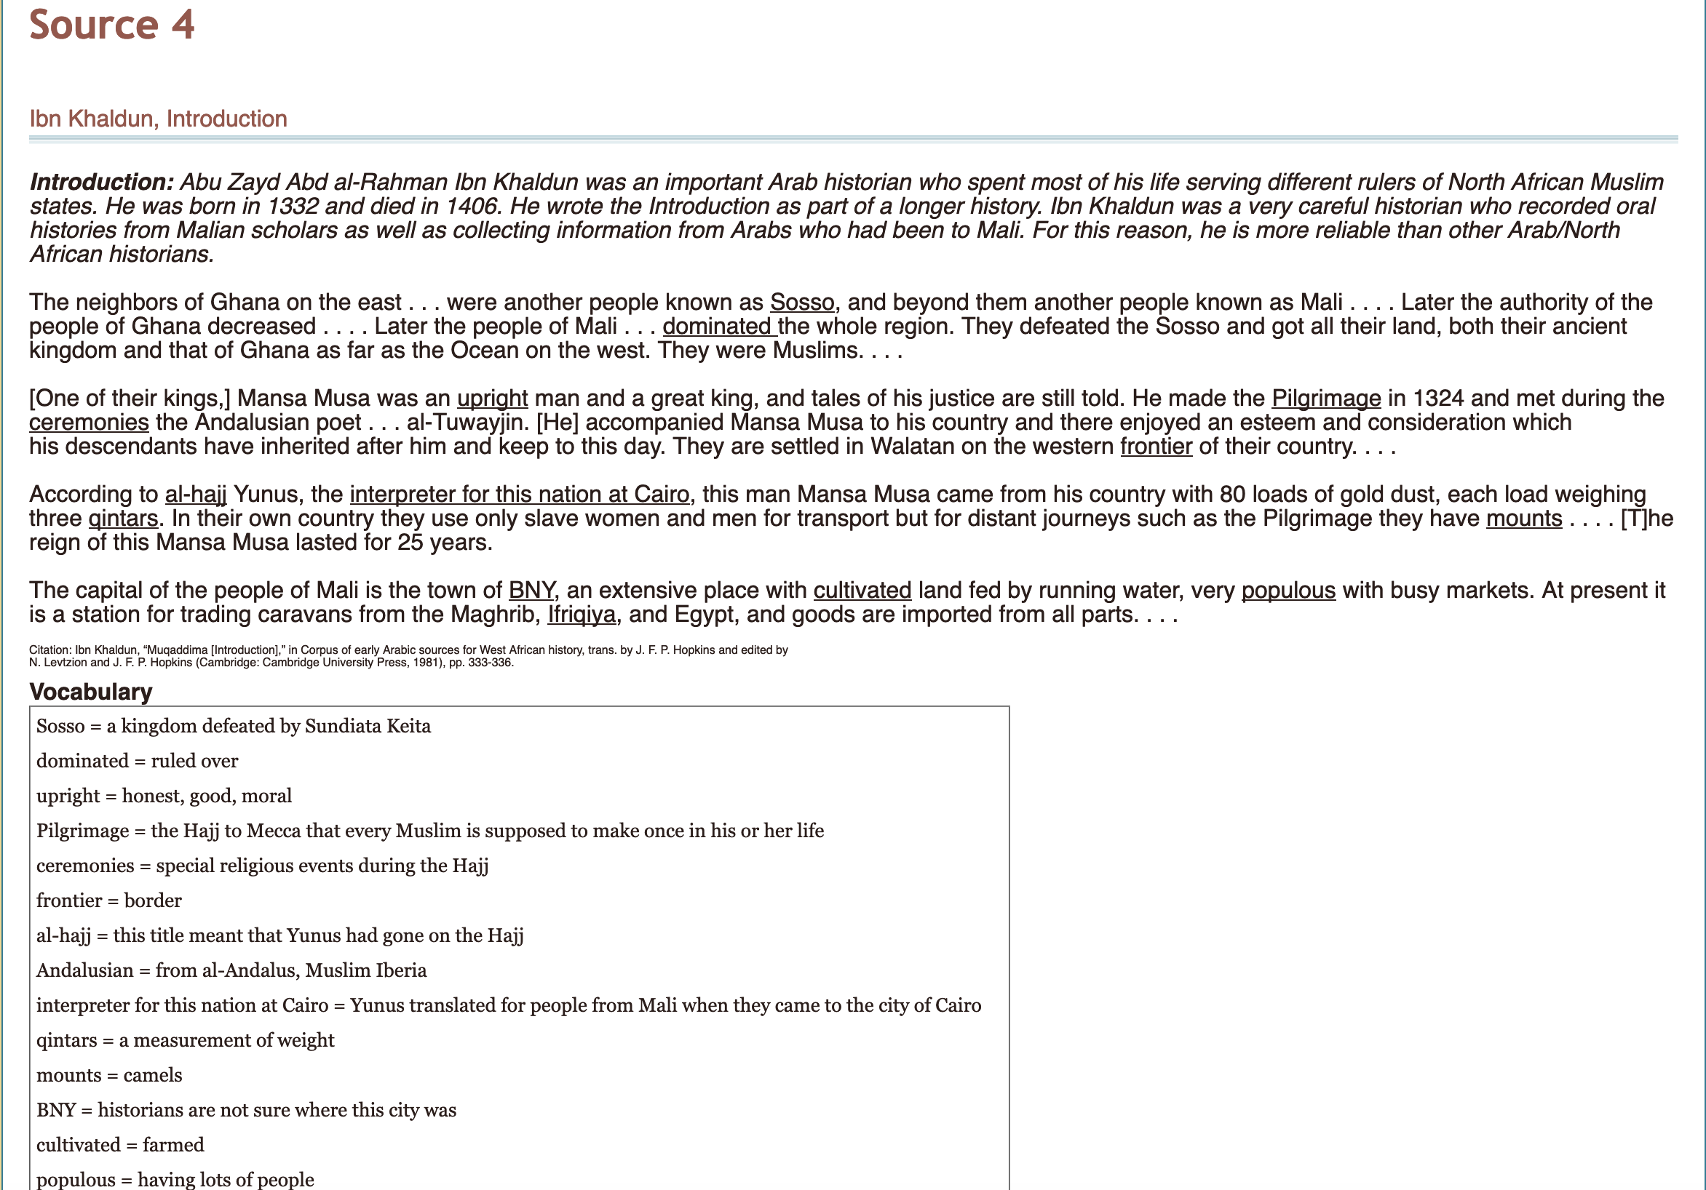
Classroom materials
Download the .pdfs of these sources from https://sites.google.com/site/medievalsitesofencounter/mali/west-african-and-north-africanarab-perspectives-on-mali : Source 1 (Al-Bakri), Source 4 (Ibn Khaldun), Source 5 (Ibn Battuta). Have them answer the exercise questions.

Slide 7
Music and performance

Slide 8
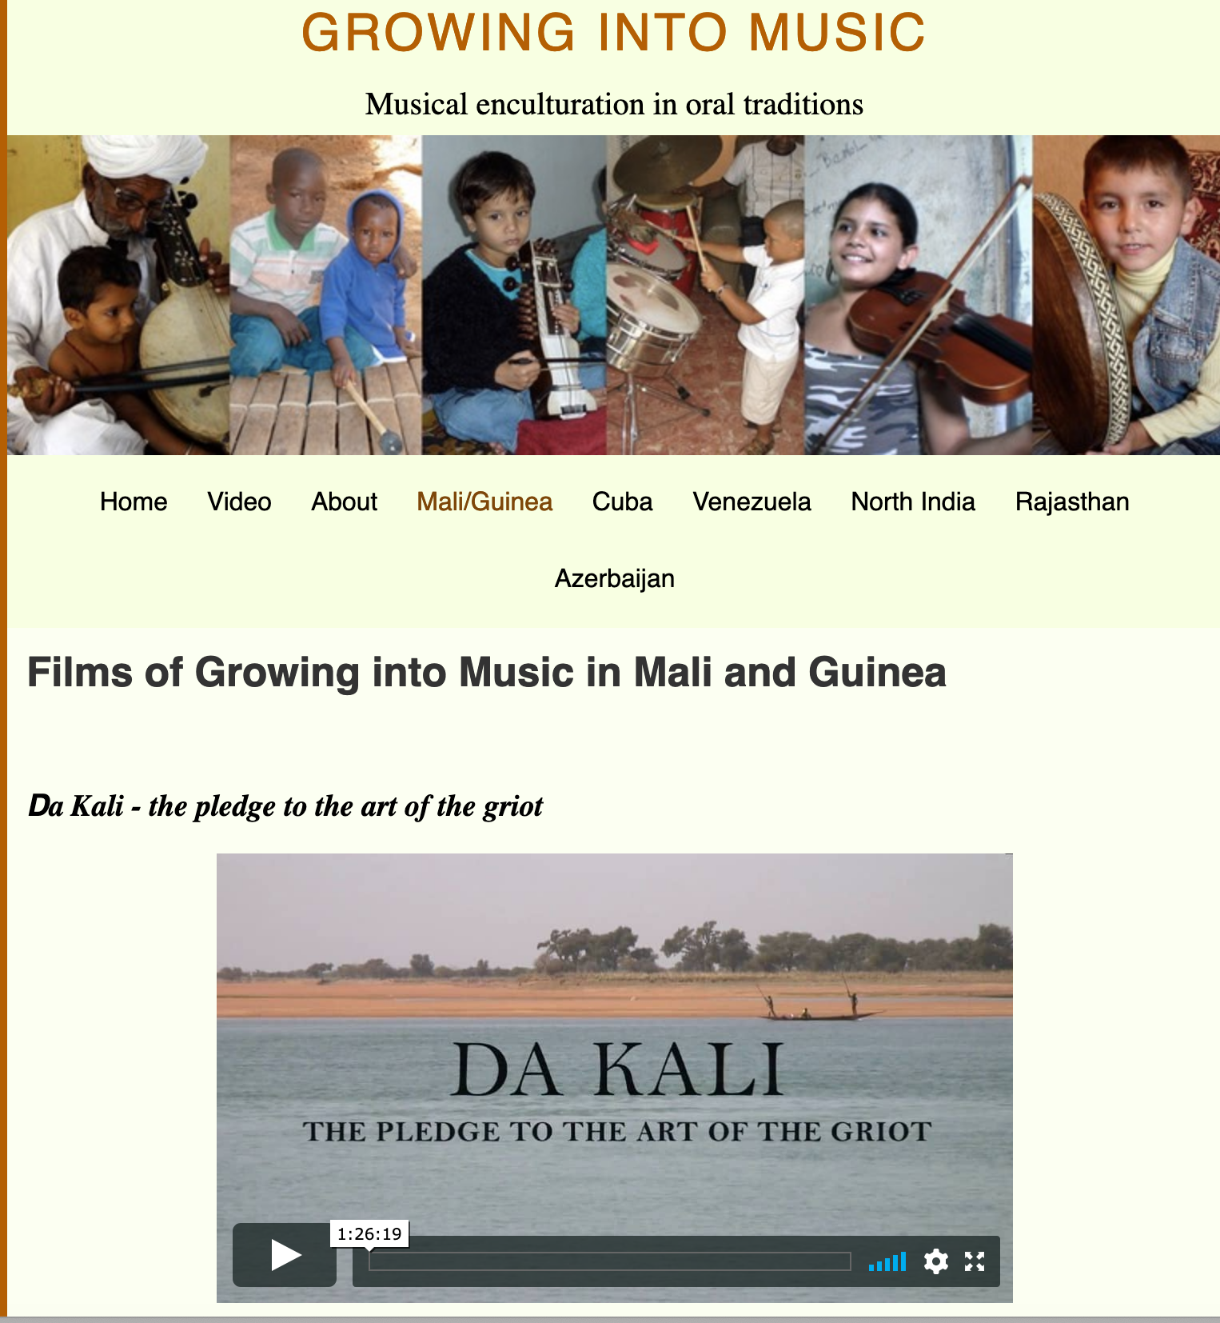
Resources for teaching with music and performance
ORIAS (UC Berkeley), The Hero’s Journey: Sundiata, https://orias.berkeley.edu/sundiata.
SOAS University, “Identities in Greater Senegambia and Beyond”, SOAS University of London, https://www.youtube.com/watch?v=RKVC5PpTTDQ . A fantastic example of ways to teach history and music together, and some excellent background for teachers on music in the region.
Growing Into Music, “Music of Mali and Guinea”, http://www.growingintomusic.co.uk/mali-and-guinea-music-of/ . Includes many participants in the region. Includes Da Kali – the pledge to the art of the griot.
“The pledge to the art of the griot”, (http://www.growingintomusic.co.uk/mali-and-guinea-music-of/films-of-growing-into-music.html). Shot 2009-2012, the children of four families try to become griots.
“The Griots of West Africa”, Goethe Institut, http://www.goethe.de/ins/za/prj/wom/osm/en9606618.htm .

Slide 9
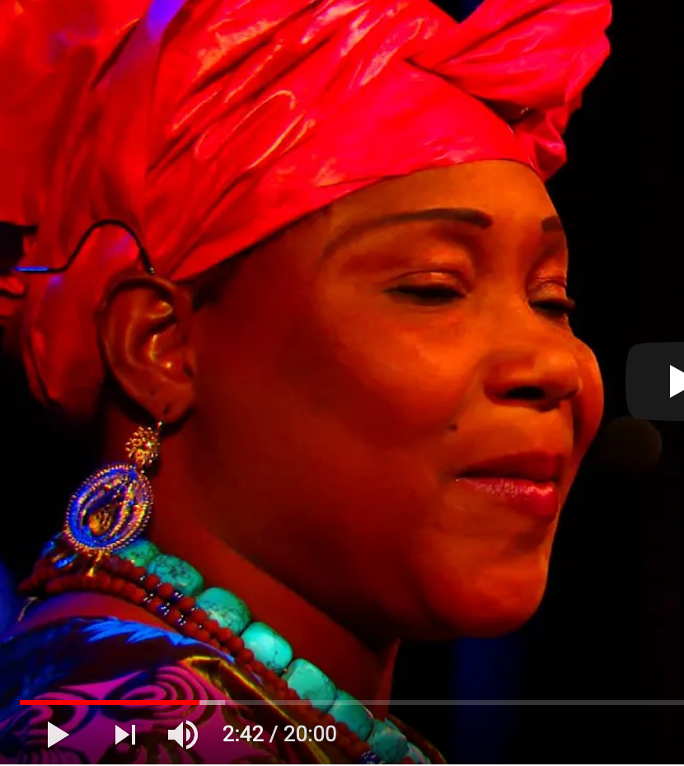
Classroom materials
Intro: Have students watch the very short video, Sundiata: The Heritage of a Griot - https://youtu.be/oQP4gM5Na54 .
Performances of the Sundiata story.
Perform the play Sundiata: Lion King of Mali, https://orias.berkeley.edu/sites/default/files/sundiatascript.pdf
Read D.T. Niane, Sundiata: An Epic of Old Mali https://www.scarsdaleschools.k12.ny.us/cms/lib5/NY01001205/Centricity/Domain/202/Sundiata.pdf
Listen to the musical performance of the Sundiata epic, “The Sunjata Story – Glimpse of a Mande Epic”, https://www.youtube.com/watch?v=yOS78ul1_rA.
Read David Wisniewski, Sundiata: Lion King of Mali, (Clarion, 1992).

Slide 11
Architecture

Slide 12
Resources for teaching with architecture
Most of the material recommended comes from the Global Architectural History Teaching Collaborative (GAHTC), https://www2.gahtc.org/, which makes teaching modules available for free to instructors. You must register.

Slide 13
Classroom materials
See attached powerpoint: ArchitectureMali.pptx

