Slide 1
What can we learn about the Kingdom of Benin?
A focus on art and architecture

Slide 2
First look, 16th-18th century bronze plaques
The “Benin Bronzes” are mostly plaques made of brass. They were made by specialists who worked for the Oba, the King of Benin. Let’s look at some of these plaques.

Slide 3
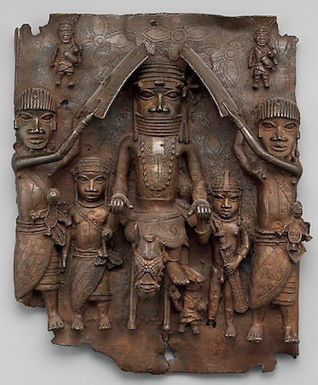
Oba on Horseback and Attendants
The Metropolitan Museum of Art

Slide 4
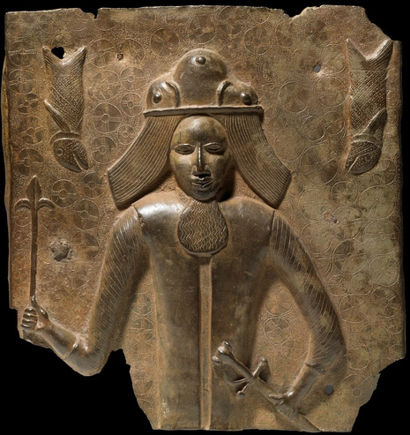
Depiction of a European
British Museum

Slide 5
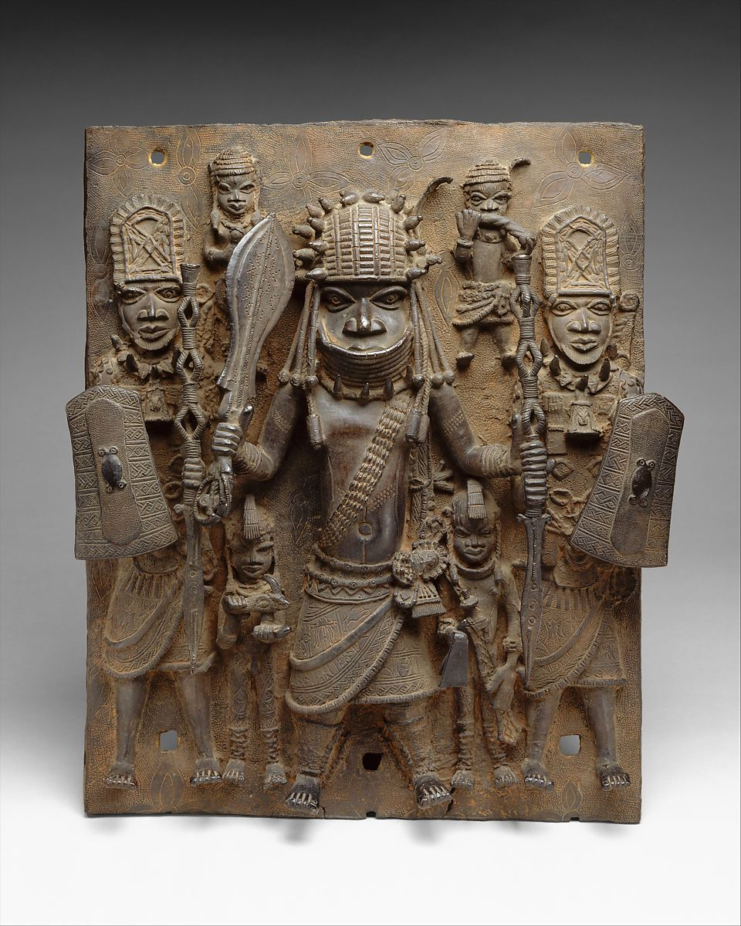
Warriors and Attendants
The Metropolitan Museum of Art

Slide 6
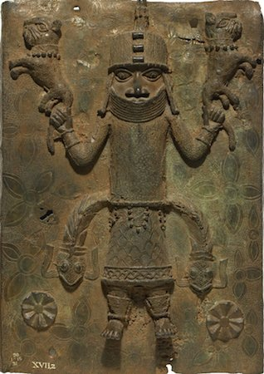
Oba (King) with mudfish emerging from his sides, swinging tame leopards
British museum

Slide 7
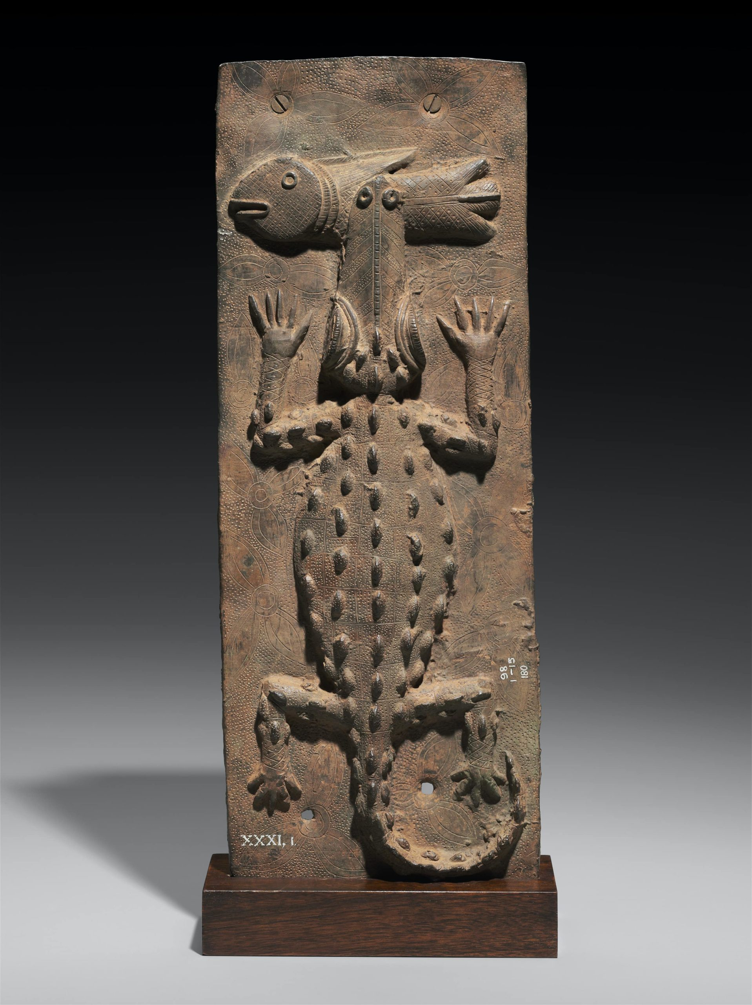
Crocodile eating a fish
Museum of Fine Arts, Boston

Slide 8
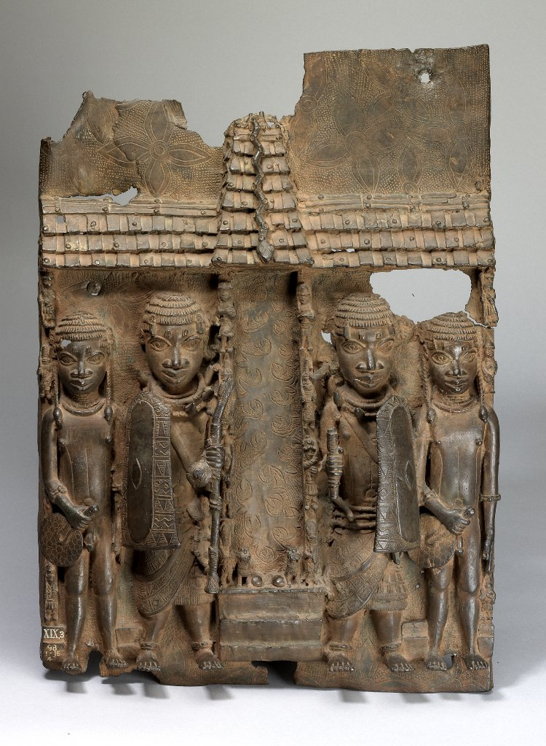
Audience Hall, receiving traders
British Museum

Slide 9
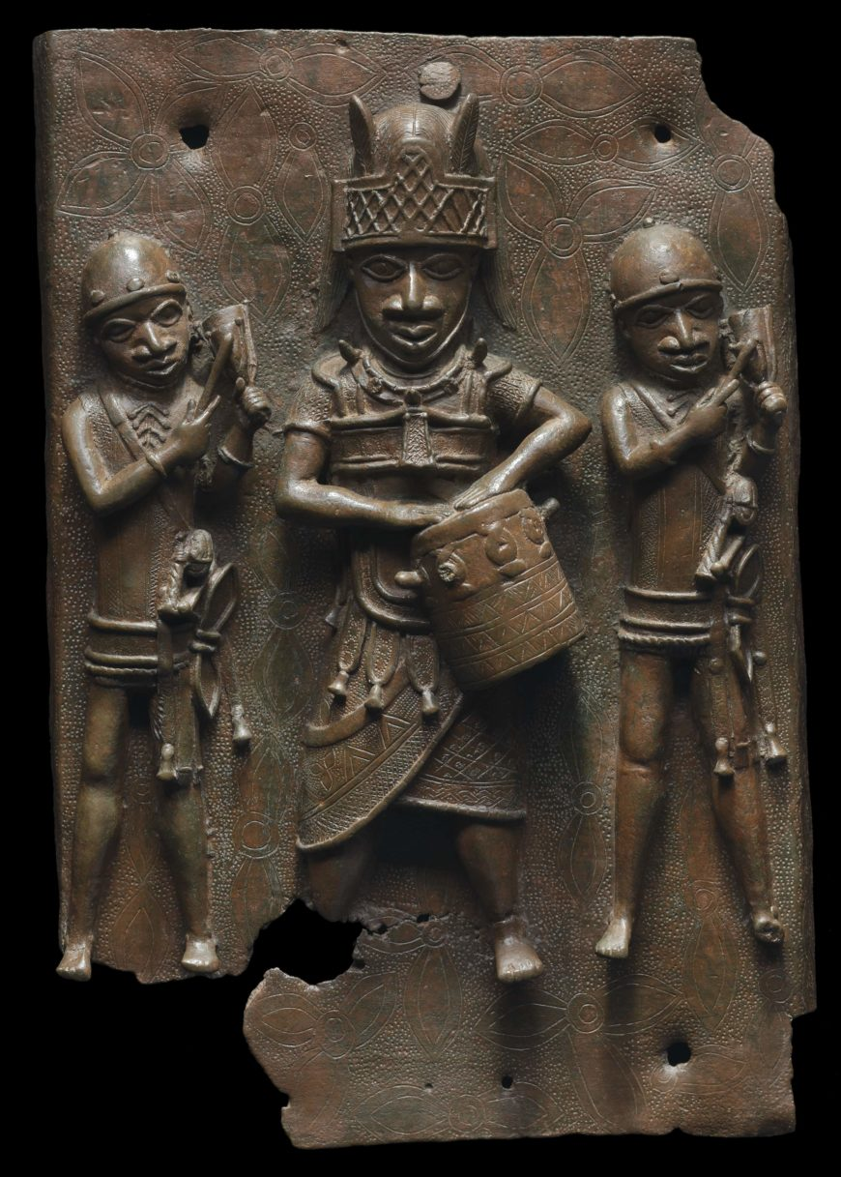
Courtiers and servants of the King
Museum of Fine Arts, Boston

Slide 10
Architectural context of the Benin bronzes
The ”Benin bronzes” were mostly taken from the walls of the palaces of the Oba, or King. Let’s explore this palace, and the city, a little bit.

Slide 11
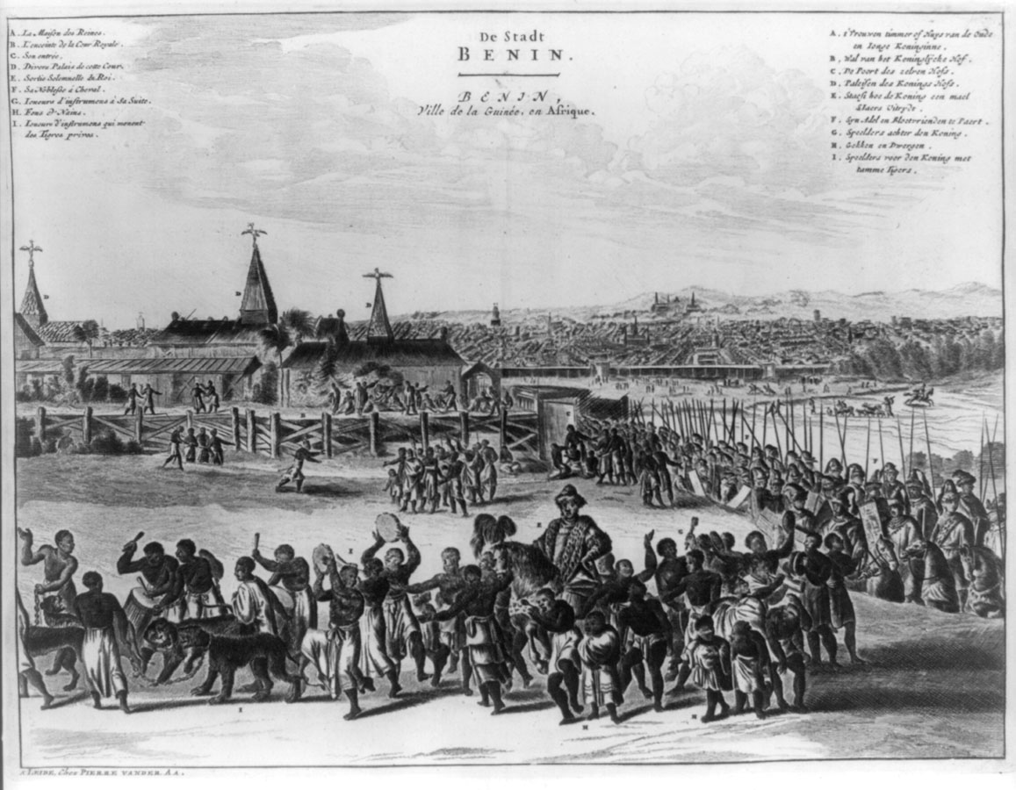
Olfert Dapper, ”De Stadt Benin”, 1668

Slide 12
Olfert Dapper, 1668*
“The king's court is square and located on the right-hand side of the city, as one enters it through the gate of Gotton. It is about the same size as the city of Haarlem and entirely surrounded by a special wall, comparable to the one which encircles the town. It is divided into many magnificent palaces, houses and apartments of the courtiers, and comprises beautiful and long squares with galleries, about as large as the Exchange at Amsterdam. The buildings are of different sizes however, resting on wooden pillars, from top to bottom lined with copper casts, on which pictures of their war exploits and battles are engraved. All of them are being very well maintained. Most of the buildings within this court are covered with palm leaves, instead of with square planks, and every roof is adorned with a small spired tower, on which casted copper birds are standing, being very artfully sculpted and lifelike with their wings spread.”
*Dapper himself never visited Benin and relied on reports from returning sailors

Slide 13
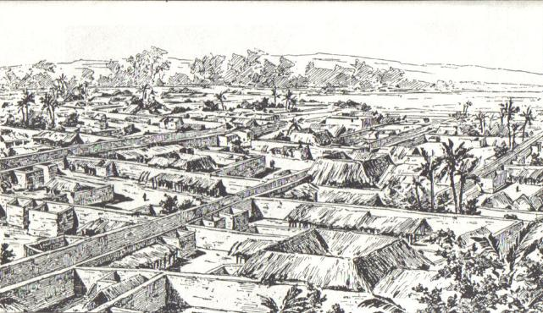
Benin City by direct observation, sketch of a British officer, 1897 (prior to destruction by British forces)

Slide 14
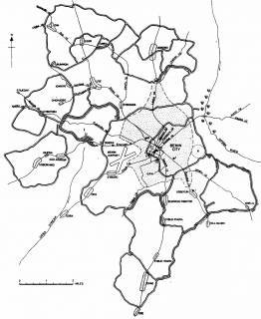
Walls of Benin City, by excavation

Slide 15
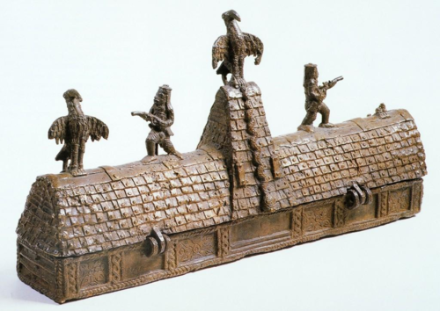
The Palace
Bronze Box, representing part of the Oba’s Palace, manufactured in Benin City

Slide 16
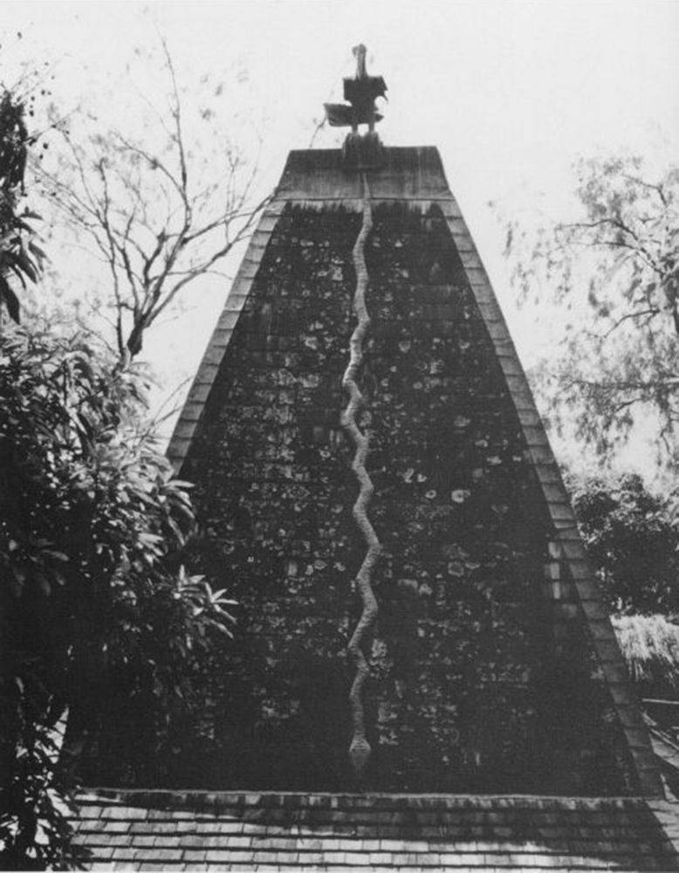
The Palace
Photograph of roofline at Oba’s Palace

Slide 17
Meaning and Symbolism

Slide 18
Kingship – decorating a palace
The kingdom had sumptuary laws – ownership of particular materials and objects was restricted to certain social classes.
Only the Oba was allowed to own brass objects
The images were designed to ‘wow’, to impress, by presenting the power, wealth, and authority of the Oba… much like palaces in Europe
They were propaganda aimed at merchants, courtiers, ambassadors, and subjects of the Oba

Slide 19
Kingship – royal regalia and gestures
The way the people in the images are dressed is important.
Their dress signifies status in a society were sumptuary laws defined people’s dress and luxuries.
Servants are dressed the simplest, courtiers wear more wealth, soldiers are in armor, kings have the most regalia.
The stance of one hand by the waist and weapons raised was a signal of loyalty
Riding on horses and having attendants also signaled power and status

Slide 20
War and soldiers
The Benin state existed in an increasingly turbulent environment in the sixteenth through nineteenth centuries. The Atlantic slave trade, in particular, made the region unsafe. That’s what led to a vast expansion of city walls.
Benin flourished in this environment, and largely subjugated many surrounding territories. Thus the profusion of soldiers in the bronzes.

Slide 21
Trade and diplomacy
Trade was also important. Benin dominated much of the trade along the coast to east and west in the seventeenth century and beyond.
Neighboring diplomats, and Europeans, arrived both for diplomacy and to arrange trade.
Benin also increasingly played an important role in brokering the Atlantic slave trade.

Slide 22
Symbolic animals
Animals are associated with the power and importance of the Oba n many Bronzes.
The Oba is metaphorically referred to as the “leopard of the house” – dangerous, cunning, graceful, important.
But another animal associated with the Oba in some Bronzes is the humble mudfish – an animal that can live both on land and in water. This association indicates that the Oba spans the spiritual/ancestral world and the current/physical world.

Slide 23
Debate: Should the Benin Bronzes be returned?

Slide 24
Say you wanna buy a debate lesson?
TES.com - https://www.tes.com/en-us/teaching-resource/benin-kingdom-lesson-9-benin-bronzes-debate-11071579
KS2History - https://www.ks2history.com/benin-lesson-plans
KeyStageHistory - https://www.keystagehistory.co.uk/keystage-2/kq6-should-the-benin-bronzes-be-returned-smart-task/
*Note: we do not endorse any of these lesson plans

Slide 25
Resolved: British and American museums should restitute (return) the Benin Bronzes to the country of Nigeria

Slide 26
Historical arguments in favor
The Bronzes were taken by British forces in 1897, after an expedition that left the city and palace destroyed. The bronzes were among the spoils seized from the palace. They were therefore stolen.
The Bronzes were taken as part of the institution of colonialism, which forcefully put the people of Benin City, the Kingdom of Benin, (and Nigeria)under colonial rule for more than 60 years.
The Benin Bronzes are part of the cultural heritage of the people of the Kingdom of Benin, and Nigeria more broadly, and they should be returned to them as their cultural property.

Slide 27
Contemporary arguments in favor
Lots of art has been repatriated or restituted to the people from whom it has been seized. One example is art that the Nazis stole from Jewish people during the Holocaust.
The government of Nigeria has asked for all, or at least some, of the art to be returned.
There are few museums and little historical art retained in Nigeria. Currently, the people of Benin City and Nigeria as a whole cannot see artwork their own ancestors made, including these bronzes.

Slide 28
Historical arguments against
The bronzes were allegedly at least partly made from metal traded to the Oba [King] in return for people, mostly from outside of Benin, whom the Oba’s soldiers had enslaved. So if the bronzes should go anywhere, it should go to the descendants of those enslaved people.
The expedition that burned down Benin City and resulted in the seizure of these artifacts was in retaliation for the deaths of an expedition under British official James Phillips. They were killed by some citizens of Benin. Therefore, the Benin Bronzes are actually spoils of war.

Slide 29
Contemporary arguments against
Everyone in the world has an interest in the preservation and enjoyment of cultural property, no matter where it is from. In fact, it is important that people get to see art from other countries, so that we can appreciate each other.
Nigerian museums do not have a good track-record for preserving art, or protecting it from theft. European and American museums have a better track record. They can protect these important artifacts carefully.

Slide 30
Sources
Neil MacGregor, “To Shape the Citizens of ‘That Great City, The world”, in Whose Culture?: The Promise of museums and the Debate over Antiquities , James Como, Editor, Princeton University Press, https://elespejohumeante.files.wordpress.com/2016/08/0691133336_0691154430.pdf 2012.
Salome Kiwara-Wilson, “Restituting Colonial Plunder: the Case for Benin Bronzes and Ivories”, DePaul Journal of Art, Technology & Intellectual Property, 23, 2013, https://via.library.depaul.edu/cgi/viewcontent.cgi?referer=https://www.google.com/&httpsredir=1&article=1052&context=jatip.
Charlotta Dohlvik, “Museums and their Voices: A Contemporary Study of the Benin Bronzes”, MA Dissertation, Gotenborg University, 2006. https://gu.se/digitalAssets/805/805960_Dissertation_Charlotta_Dohlvik.pdf
Christine Mungai, “Who Are Western Museums Guarding African Artefacts From?” Al Jazeera, December 3, 2018. https://www.aljazeera.com/indepth/opinion/western-museums-guarding-african-artefacts-181203115612952.html.
Tiffany Jenkins, “Why western museums should keep their African treasures”, The Guardian, 25 November, 2018. https://www.theguardian.com/culture/2018/nov/25/benin-bronzes-why-western-museums-should-keep-treasures?fbclid=IwAR3lya1GHo92cM6FKcy1mHgsg0QcpLdNgg2Krp07bdeVO_GL4KTwsG51IdE

