Slide 1
What were African kingdoms like before colonisation?

Slide 2
By the end of this lesson you will…
Have an overview of what African Kingdoms were like before 1800
Understand the techniques we can use to investigate earlier periods of history

Slide 3
To get you thinking…
In 1963, the Oxford historian, Hugh Trevor-Roper, stated: “at present there is none, or very little [African history]: there is only the history of the Europeans in Africa.”
What do you think?

Slide 4
To get you thinking…
Imagine you are being sent Jos in Nigeria
Upon arriving in Jos, how would you start to learn about its history? What historical tools and strategies might you use to learn about the past?
Think! Pair! Share!

Slide 5
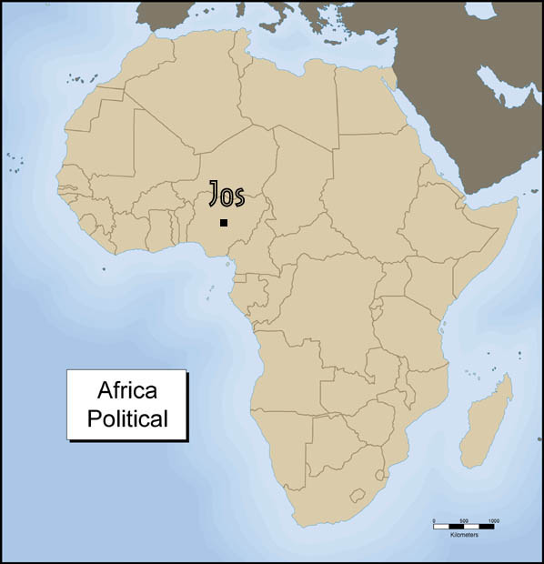

Slide 6
What might you have come up with?
Have a look at the cards. They highlight four major areas of analysis that tell historians something about the past. It also gives an example for each of these, describing how they might be used in the example of Jos, Nigeria.
Compare these with your own. Did you come up with any different ideas? What were they? Any of the same ideas? What were they?

Slide 7
discussion
In sharing with your classmates some of the ways you would learn about history in Jos, Nigeria, you have probably noticed that everyone's ideas and approaches are a little bit different. Do you think that if each of you actually carried out your plan for learning about Jos history you would all come up with exactly the same thing? Why or why not?

Slide 8
What were some of the main kingdoms of West africa?
This activity will introduce you to three of the great kingdoms of West Africa between the 9th and 16th centuries CE. They are the kingdoms of Ghana, Mali, and Songhay.
In groups of three, investigate one of the three kingdoms by reading the relevant text
There is then a fourth text which you should all read, explaining the time when parts of North Africa came to be Islamic.
Use your map as a reference while you are reading the texts. The map shows the location of the three kingdoms of West Africa, as well as, many other kingdoms and empires throughout African history.

Slide 9
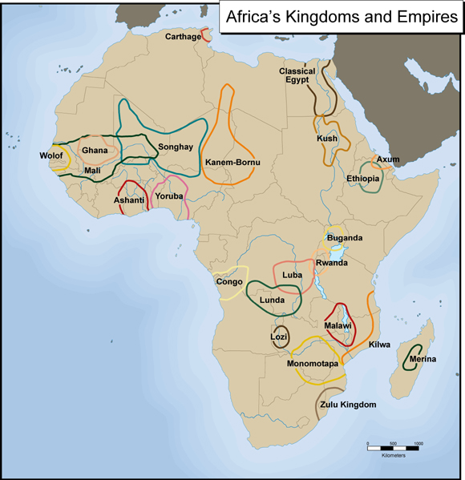

Slide 10
What were some of the main kingdoms of West africa?
Feedback to your group and discuss how the events in the four texts are related to one another.

Slide 11
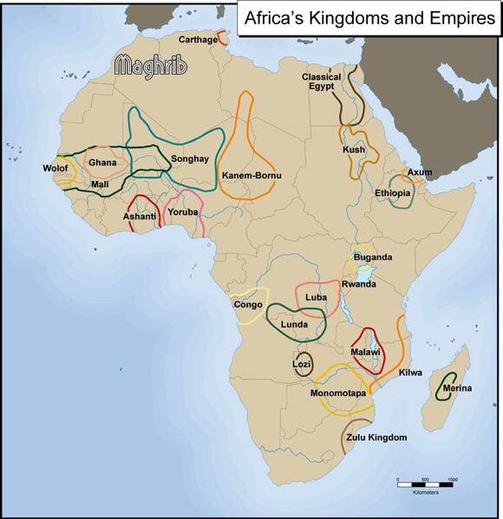

Slide 12
How are the different kingdoms connected?
You have been asked to think about connections and relationships between the Kingdoms of Ghana, Mali, Songhay, and the Maghrib.
Using the graphic organisers, fill in one connection or relationship between each of the areas you have read about.

Slide 13
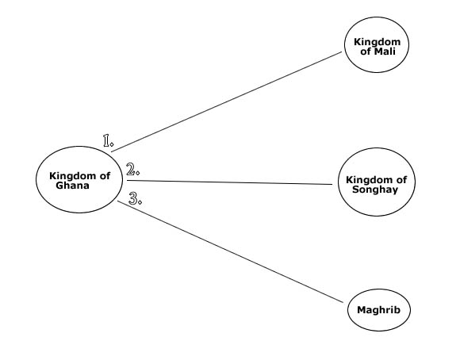

Slide 14
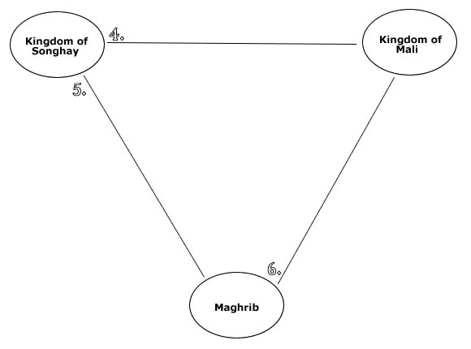

Slide 16
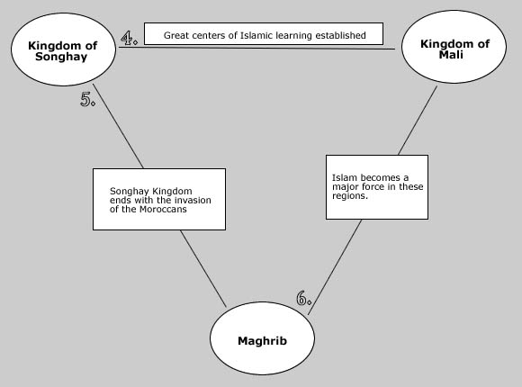

Slide 17
homework
Use Pearson extract pp.338-340 to research the following question:-
How did Islam spread south of the Sahara?

Slide 18
And to finish…
What are the three most important learning points of this lesson?

