Slide 1
West Africa:
The Asante Empire
Toby Green
King’s College, London

Slide 2
Overview of Presentation
Outline of Background and Key Facts of Asante
Key Contexts for the Study of Asante
More resources
Resources for teaching Asante History

Slide 3
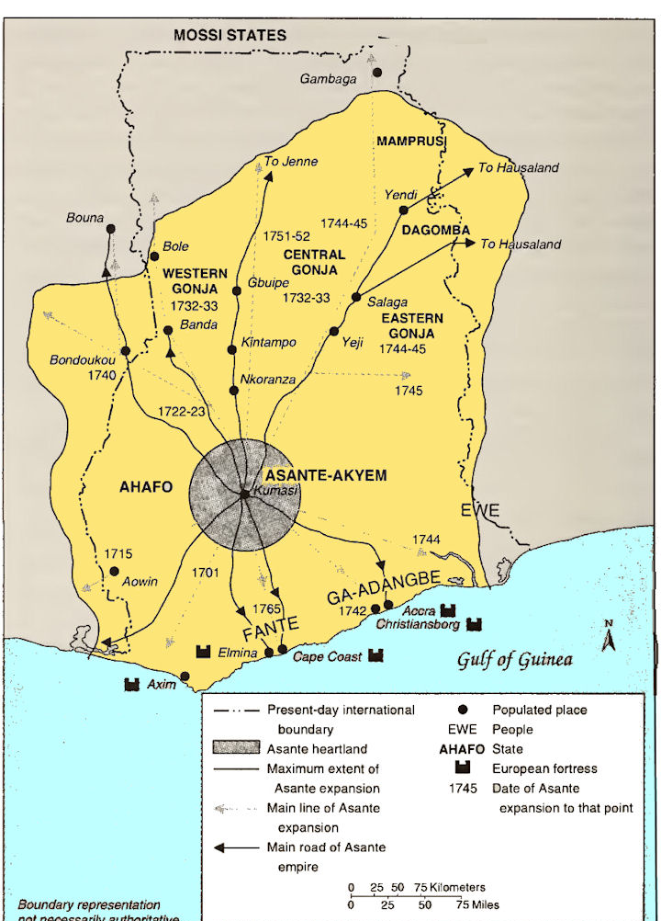
Asante Empire in the 18th Century

Slide 4
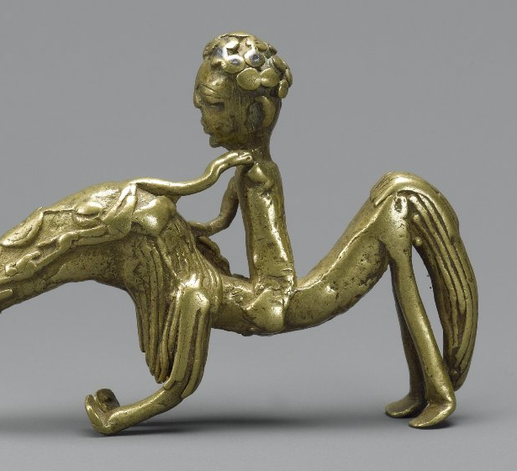
Material Culture and Teaching Asante History: Asante gold weights
Equestrian statue, Brooklyn Museum 81.168.1

Slide 5
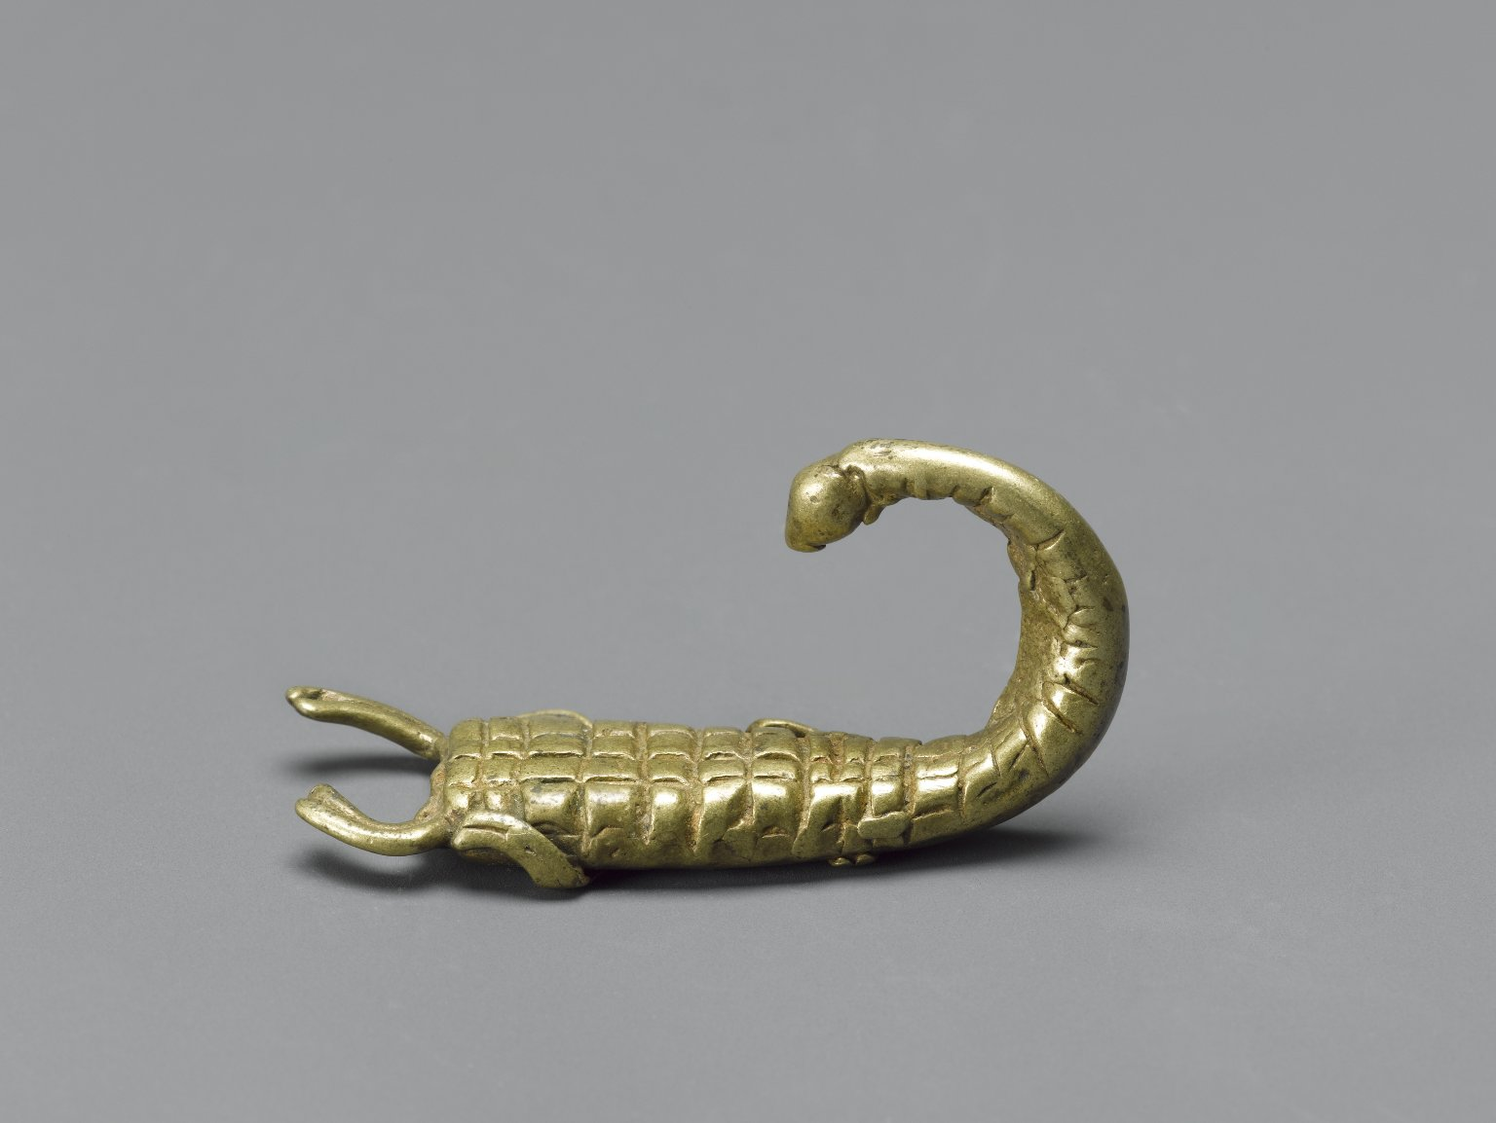
Natural history
Scorpion gold weight
Brooklyn Museum of Art 88.192.66

Slide 6
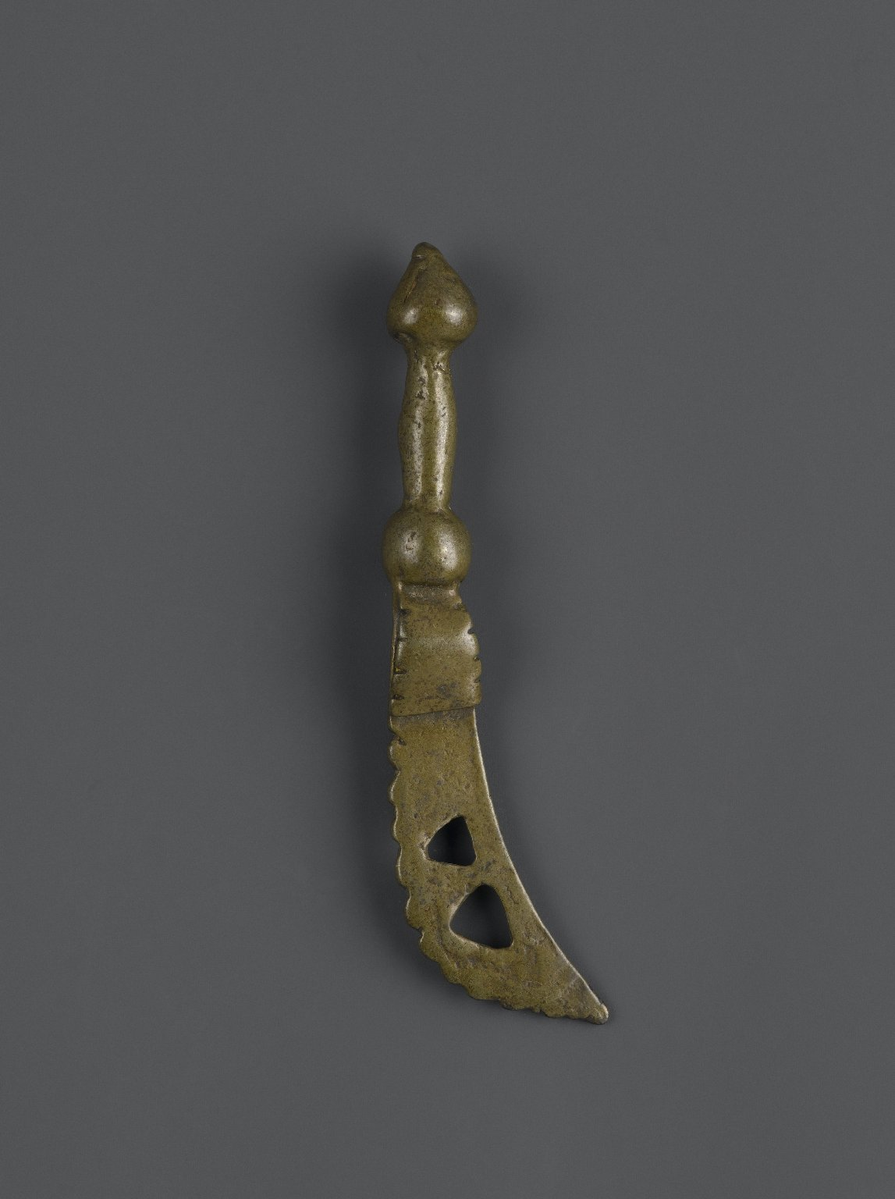
Warfare
Sword gold weight
Brooklyn Museum of Art, 74.218.24

Slide 7
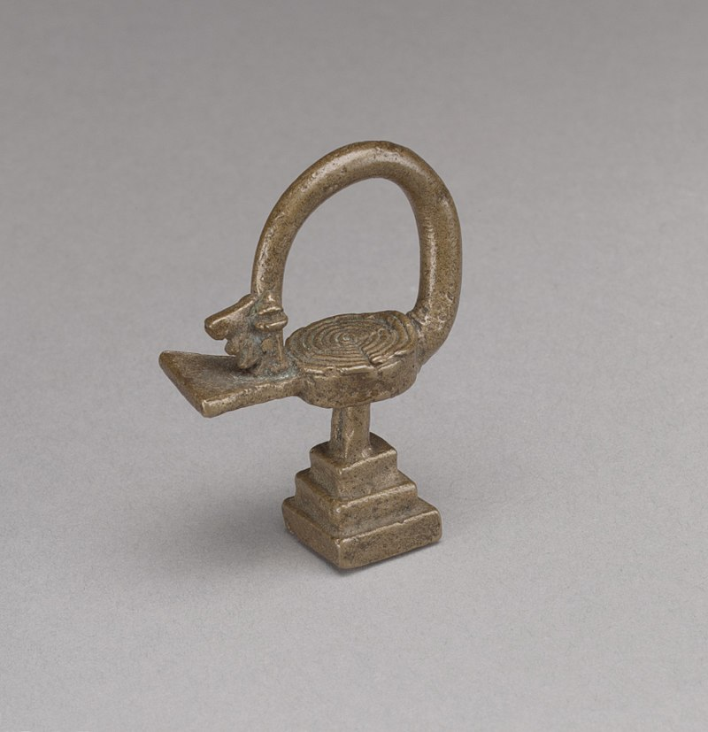
Symvbolic worldviews
Sankofa bird
Metropolitan Museum of Art, Wikicommons,
https://commons.wikimedia.org/w/index.php?search=sankofa&title=Special%3ASearch&go=Go&ns0=1&ns6=1&ns12=1&ns14=1&ns100=1&ns106=1#/media/File:Gold_Weight-_Bird_(Sankofa)_MET_DP102133.jpg

Slide 8
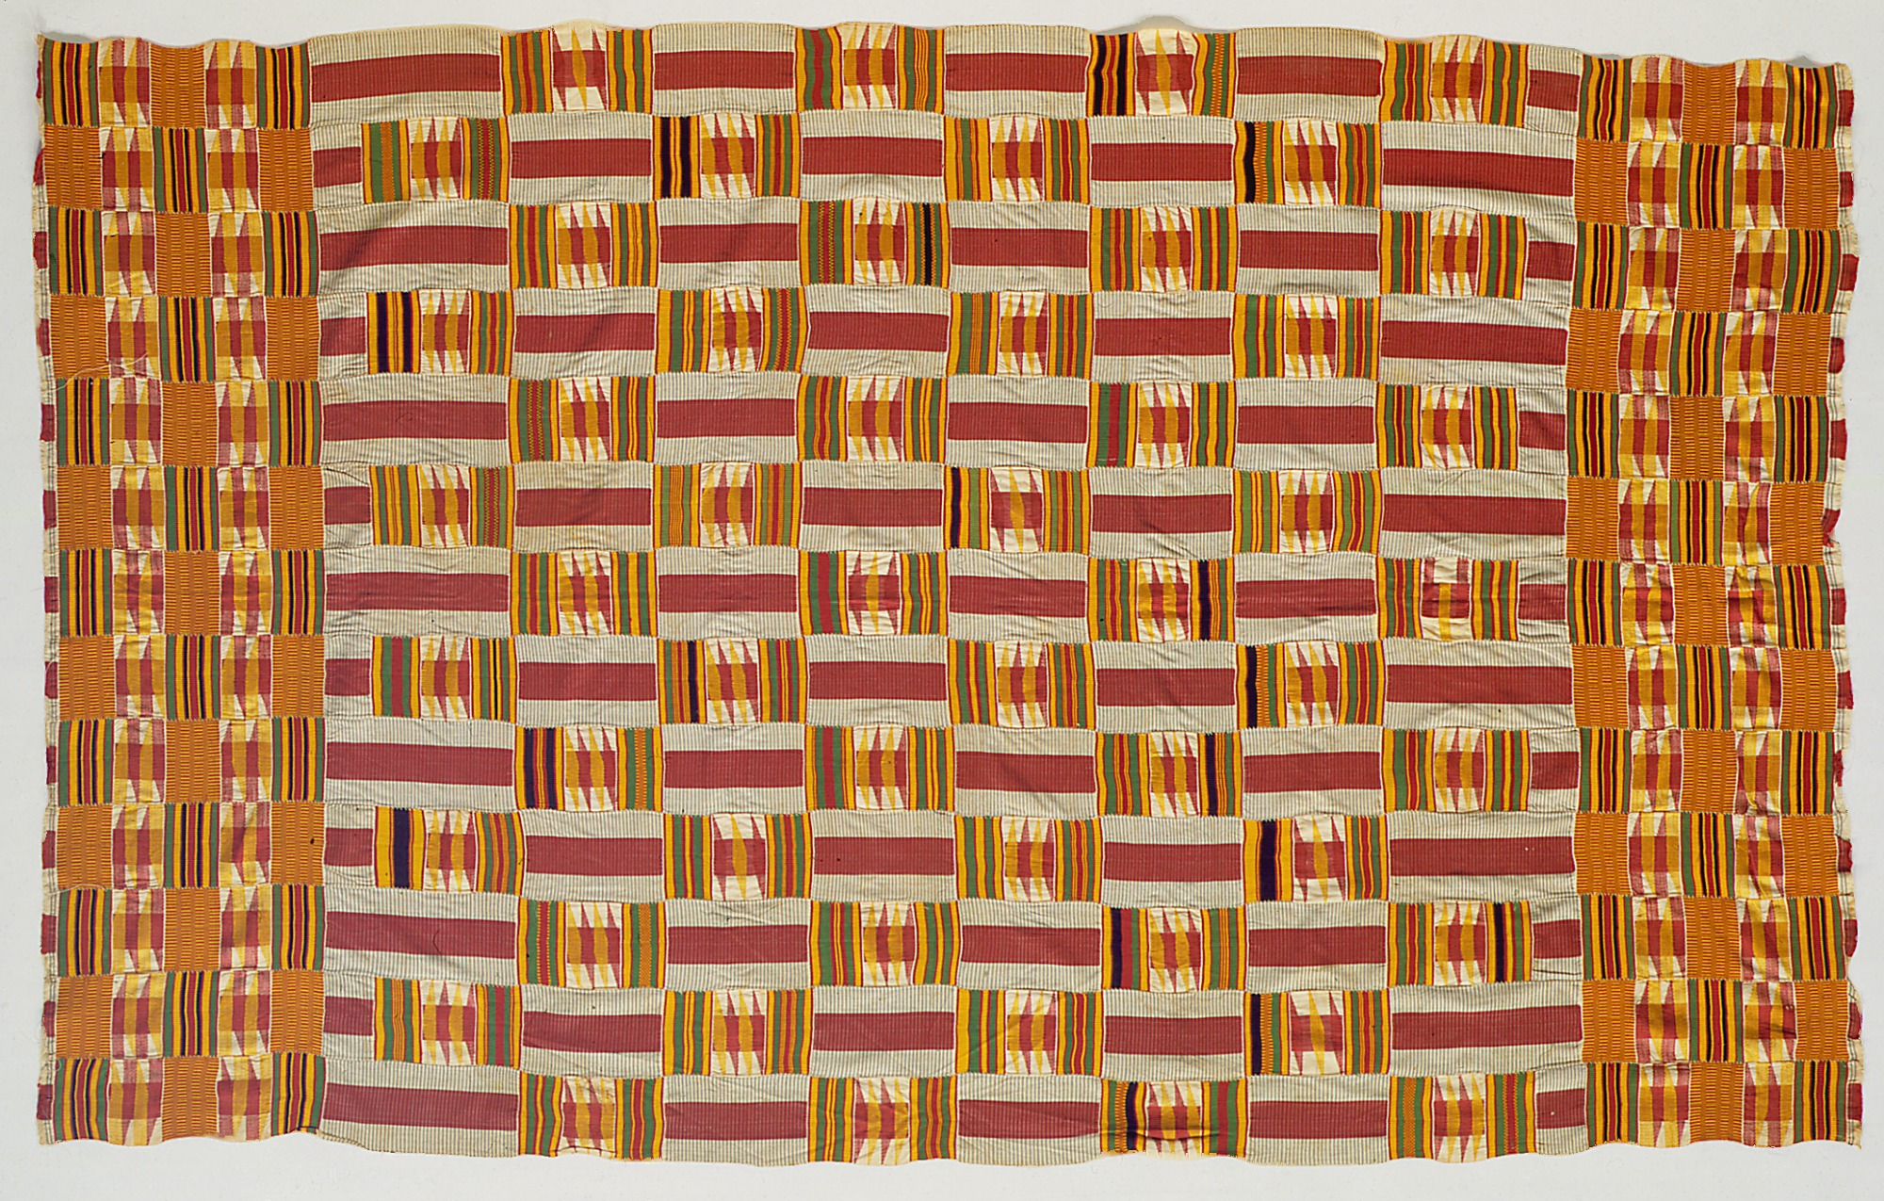
And then Kente cloth…
Woman’s Kente cloth,
Detroit Institute of Art

Slide 9
Sankofa birds…
The Sankofa represents a bird with its head turned backwards with its feet facing forwards
Sankofa is often associated with the proverb, “Se wo were fi na wosankofa a yenkyi," which translates as: "It is not wrong to go back for that which you have forgotten
Widely found in goldweights, which shows how far proverbs, material culture/economy, and the natural world intersect in Asante worldviews

Slide 10
Asante Empire: Timeline and Overview
Precursors…Bono Mansu, Akwamu, Denkyira
Bono Mansu is the earliest, centred around gold mining in the rich forests north of the coast – centred in what is now Brong Ahafo, the gold trade growing from around the 12th century. Major trading centres included Bono Mansu and Begho
Akwamu and Denkyira, rise in the 17th century, major trading partners of Europeans and controlling the gold trade
The slave trade from what is now Ghana only begins in earnest in the late 17th century

Slide 11
Asante timeline (1)
By mid-17th century the Denkyira federation, located to the south of Kumasi, is in control of gold production and power between Asante and the coast.
From the 1670s onwards, the head of the Oyoko clan, Osei Kofi Tutu I began to marshal troops against Denkyira, under the aegis of the unifying golden stool (throne) which is believed to contain the sunsum (spirit, soul) of the Asante people
1680-1700: A series of wars between the different statelets of the Gold Coast before the Asante empire rises in the early 1700s
1701: The Asante defeat Denkyira at the Battle of Feyiase under the first Asantehene Osei Tutu (1695-1717), and his advisor Okomfo Anokye
Thereafter Asante declares independence and forms a loose confederation
1717-1730s: Osei Tutu’s successor Opoku Ware I extends Asante’s control to much of modern Ghana – to the north incorporates Mossi (borders of Burkina Faso), and to the south the Fante confederation, with the border at the Pra river
The Asante army and state structures grew rapidly in this period – levies of people to build roads, serve in the army, etc. The main road from Kumasi to Cape Coast today remains the old military road built by the Asante.
1764-1777: Asante’s ruler, Osei Kwadwo, brings in a meritocratic system for the appointment of officials

Slide 12
Asante timeline (2)
1806: Asante begins a cycle of perpetual warfare and expansion, which continues until the end of the precolonial era in 1896. It begins with wars against the Fante at the coast, who had refused to release two rebels, sheltered by the British at Cape Coast.
Throughout the 19th century, one of Asante’s main trading routes is the kolanut trade to Kano in northern Nigeria, in return for indigo-dyed cloth and other goods in the trans-Saharan trade
1817: British interest in Ashanti has grown and they send Thomas Bowdich as an envoy to Kumasi, who writes a book about it.
1823: The British under Sir Charles MacCarthy attack Kumasi but are defeated.
1831: Peace treaty signed with the Britush for 30 years with the Pra river the border.
Anglo-Ashanti wars follow in 1863 and 1874, with each time it ending in stalemate – although in the latter case Kumasi was occupied and the palace burnt
1895: Asante refuses to become a British protectorate

Slide 13
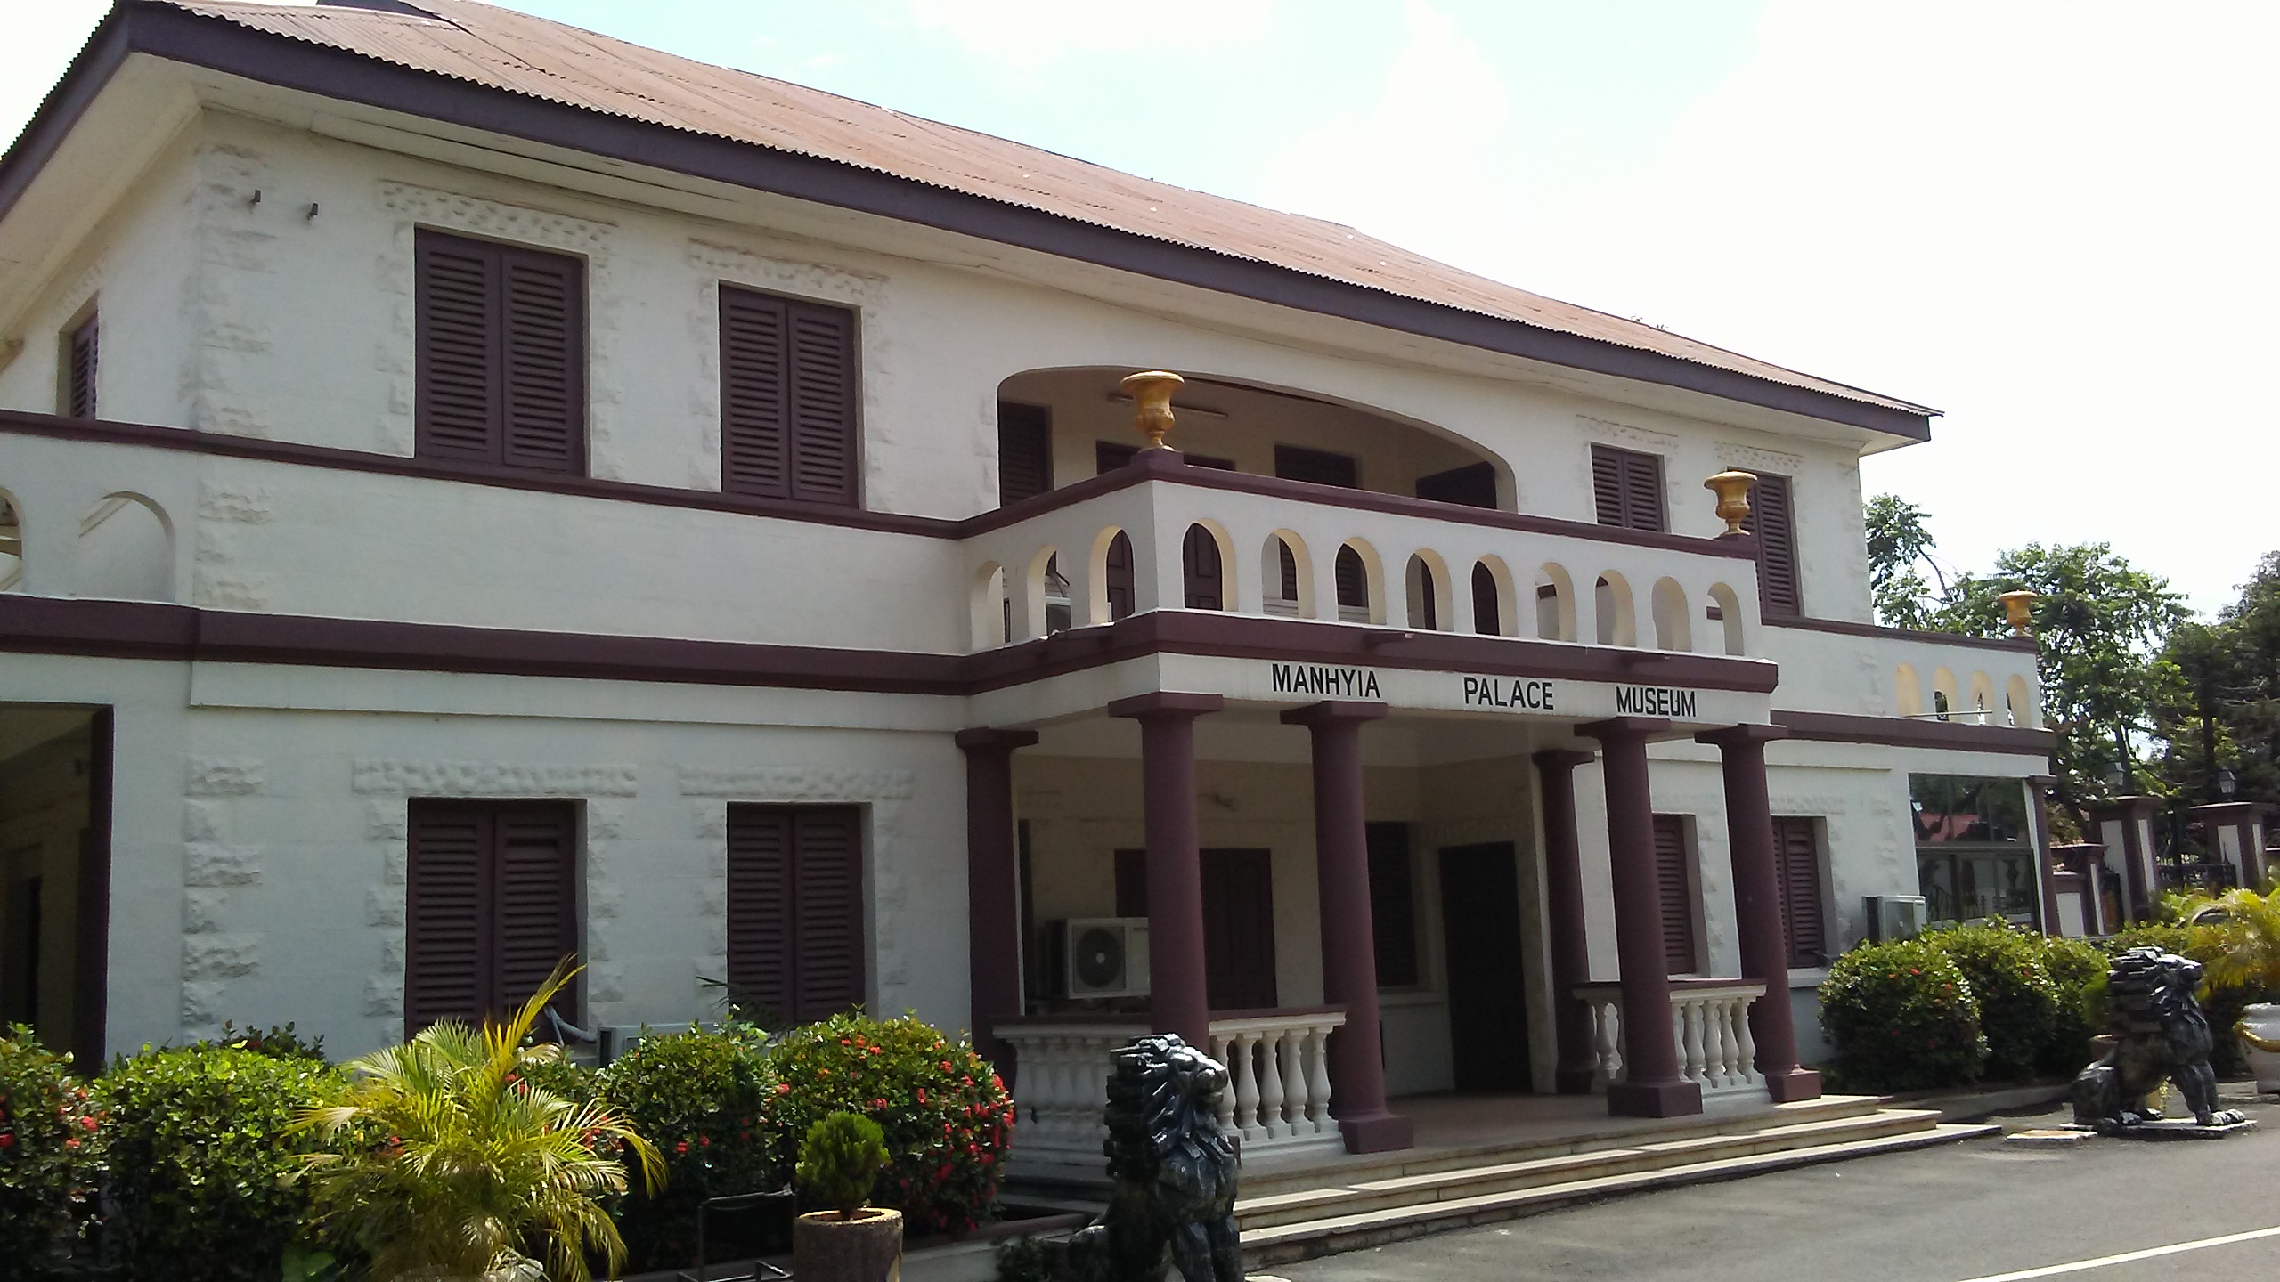
Asante contexts: (1) Gold
Manhyia Palace, Museum of Asante history – Asante, “the kingdom of gold”

Slide 14
Gold as currency and power
The importance of gold in daily life – the enormous number of gold weights produced for daily transactions
The gold trade was central to economic life – gold was the major trade of the “Gold Coast” until 1700, thereafter gold dust was the main currency of the kingdom alongside cowries which were used to trade with neighbouring kingdoms
Asante received much gold as tribute from neighbouring states, and had teams of craftsmen there who worked it into various objects symbolic of royal authority: including the golden stool

Slide 15
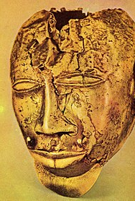
Gold and Power in Asante
https://www.metmuseum.org/toah/hd/asan_2/hd_asan_2.htm – Gold in Asante court arts
R: gLeftlden mask, property of an Asantehene

Slide 16
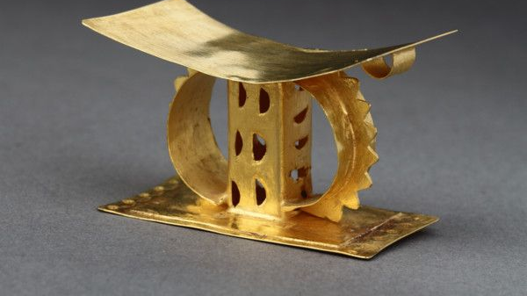
The Golden Stool

Slide 17
Asante contexts (2): State structures
State power was very important in Asante – it is a clear example of what Western historians call “A fiscal-military state”: a state that grew as it developed its tax base and therefore funded a growing army
Warfare was fundamental to the concept of Asante – “Asante” means “because of war” in Twi, symbolic of the growing importance of warfare to state structures in Africa and Europe by the late 17th century
With the rising state grew a very complex bureaucracy: a large imperial bureaucracy handled every aspect of state business,s including taxation, foreign affairs, and law.

Slide 18
State structure, continued:
There was a national assembly, the Asantemanhyiamu, of 200 elder chiefs who took government business and resolved disputes
There was also an inner council, the Ashanti Kotoko, of 18 nobles in Kumasi, who advised the Asantehene
Much of the bureaucracy was run by the Asantehemaa, the Queen Mother, who also nominated the successor of the Asantehene.
There were complex systems of taxation, and a treasury which controlled the gold reserves. The foreign affairs department conducted negotiations and treaties with separate offices to deal with the British, Dutch, Arab traders, and other nations

Slide 19
Asante contexts, 3: Between Atlantic and Saharan Trading systems
When the British captured Kumasi in 1874, they found a large library at the Mahnyia palace, with books in many languages including Arabic
Symbolic of Asante’s powerful position at the heart of two trade routes – Atlantic and Saharan
With architecture which shows some Islamic influences but is resolutely Asante
The Atlantic trade is first in gold and then captives; the Saharan trade through Kano goes through the border town of Salaga, which was also a centre for the slave trade

Slide 20
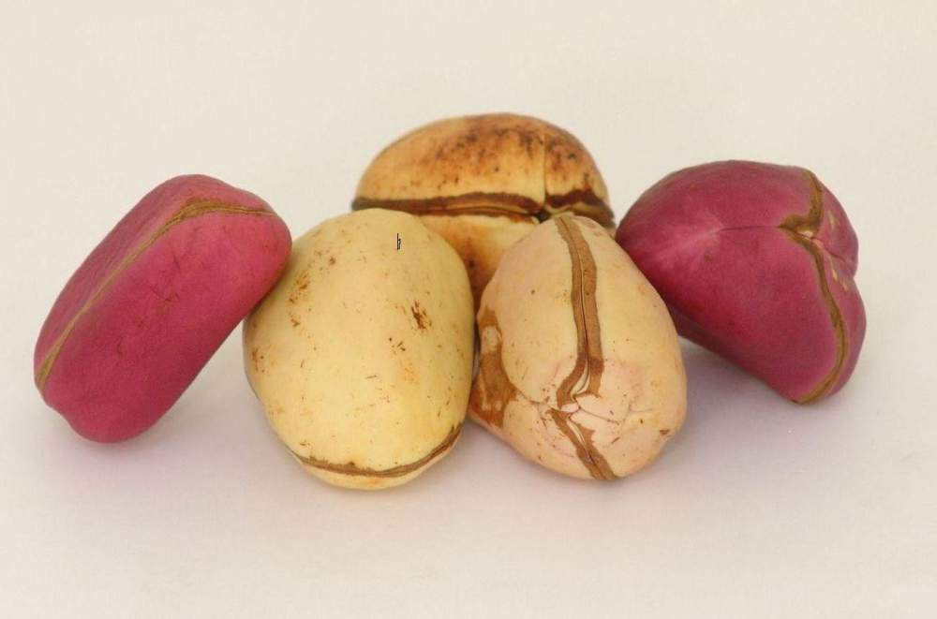
The kolanut trade to Kano, northern Nigeria

Slide 21
Asante contexts (4): Global Asante
The role of the Akan diaspora in the New World is very important (cf Kwasi Konadu)
Akan peoples formed the maroon communities in Jamaica known as the Cormantin, and were instrumental in some of the major slave revolts in the New World, especially Tacky’s War (cf Vincent Brown’s new book)
Their gold mining skills were also in high demand in Brazil in the 18th century, with a significant trade from the Gold Coast to the booming gold mines of Minas Gerais
Their cloth was also highly prized in the New World, and some of the Akan-speaking troops of a Brazilian force in the 1640s were specially sent cloths from the Gold Coast region

Slide 22
Resources
https://www.metmuseum.org/toah/hd/asan_1/hd_asan_1.htm
https://www.metmuseum.org/toah/hd/asan_2/hd_asan_2.htm
https://africa.uima.uiowa.edu/peoples/show/Asante
https://www.ghanaweb.com/GhanaHomePage/history/ashanti.php
https://www.culturesofwestafrica.com/history-ashanti-empire-colonization/

Slide 23
Further Reading
A. Adu Boahen et al, The History of Ashanti Kings and thr Whole Country Itself…by Nana Agyeman Prempeh I
Kwasi Konadu, The Akan Diaspora
TC McCaskie, State and Society in Precolonial Asante
Ivor Wilks, Asante in the Nineteenth Century

