Slide 1
What were the origins of Oyo and Dahomey?

Slide 2
By the end of this lesson you will…
Have an understanding of the early development of the kingdoms of Oyo and Dahomey

Slide 3
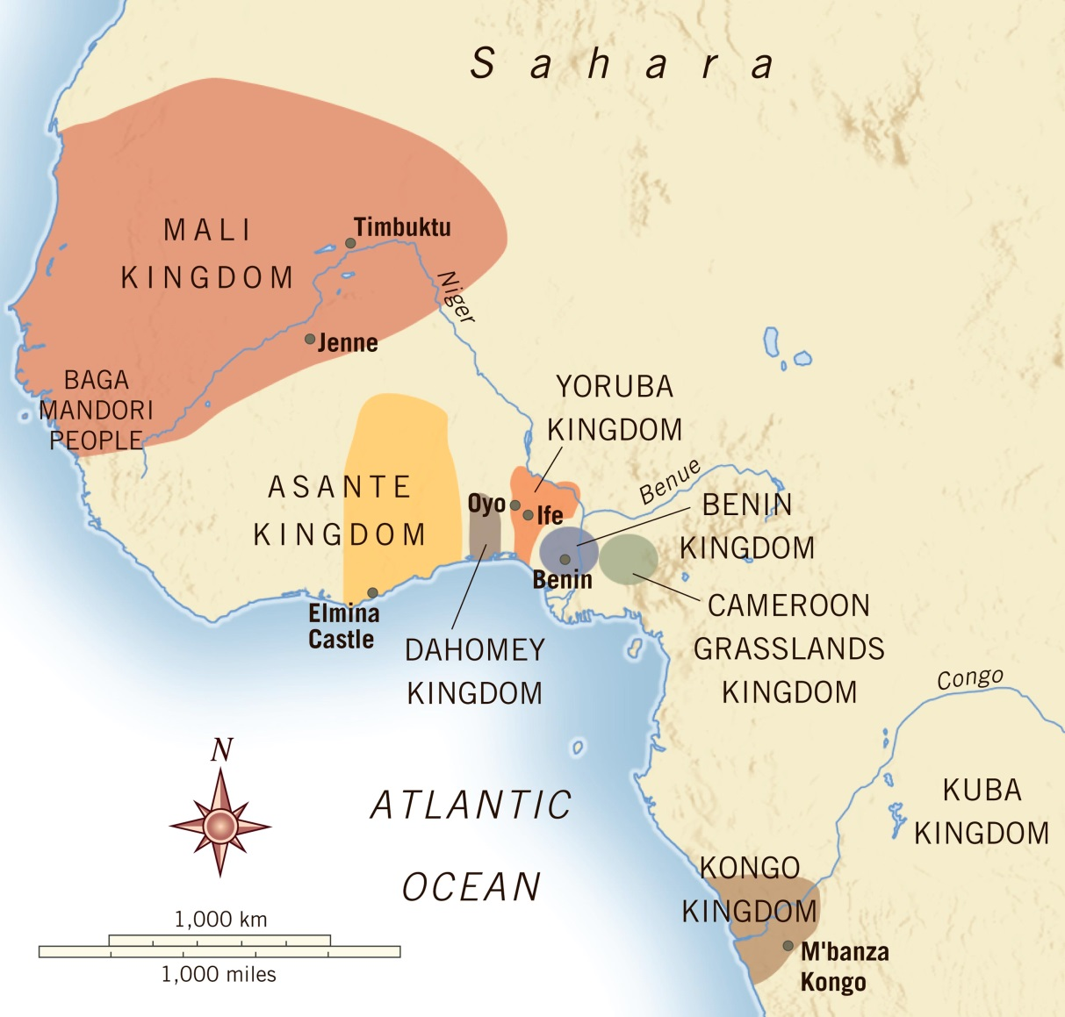
Where are the kingdoms located?

Slide 4
Where are the kingdoms located?
They straddle the border of what is today Benin and Nigeria
Oyo is located some distance inland
They were in savannah grasslands which facilitated agriculture, mobility and the development of state infrastructures of taxation, transport and military control
They were protected from coastal raids by geographical features:-
Dahomey – the Mahi swamplands and forests – kings sought to keep this wild
Oyo – thick forests which stretched north of the lagoon at Lagos

Slide 5
What were the origins of Oyo?
It was a Yoruba kingdom
The Yoruba people were the most populous people of southern Nigeria
Their origins went back to at least C14
They claim an origin at the city of Ile-Ife, the spiritual heartland of Yoruba peoples
It is said to have been founded by Oranmiyan, one of the sons of Oduduwa who dispersed from Ile-Ife
Migrants then appeared from the kingdoms of Borgu and Nupe further north, each situated between the Hausa kingdoms around the city of Kano and the Yoruba heartlands to the south

Slide 6
How did the kingdom of Oyo develop?
They traded with trans-Saharan Arab merchants
Nupe was also a major cloth-producer
C16 – Nupe united as a kingdom
It fought with Oyo for supremacy
Early C16 – Nupe invaders crossed the Niger river and sacked the Oyo capital at Oyo-Ile, founding major towns in the northern part of what would become the kingdom of Oyo
By 1600 Oyo had stopped the Nupe advance and was becoming a regional power

Slide 7
What were the origins of Dahomey?
Their rise occurred later – in the early C18
C17 – the major kingdom in the region of modern-day southern Benin was Allada, a kingdom of Aja people who had also borrowed many Yoruba traditions
Allada was a major trading partner of Europeans, sending cloth, ivory and enslaved Africans to the Dutch, Portuguese and French
Allada also had a heavy connection to Sao Tome in the Gulf of Guinea

Slide 8
How did the kingdom of Dahomey develop?
1660s – Allada was weakened as the growth of trade led to the king of Hueda (Whydah) becoming more powerful
The king of Allada sent embassies for help to Spain in 1658 and France in 1670 but to no avail
European traders then moved their forts to Hueda:-
1682 – Netherlands
1683 – England
1684 - Brandenburgers

Slide 9
How did this affect Dahomey?
1620-1650 – Dahomey was founded – it was a small kingdom
1704 – the Europeans signed a 6-clause convention with Whydah
Whydah’s internal strength then began to weaken
Agaja, the king of Dahomey, saw his opportunity
1724 – Agaja conquered Allada
1727 – he conquered Whydah
Dahomey then became the most powerful kingdom in the region

Slide 10
What was the relationship between Oyo and Dahomey?
In the second half of C18, Dahomey was a tributary to Oyo but was still feared by surrounding smaller kingdoms
Its access to European trade and its dominance over the kingdoms of Allada and Whydah made the port of Ouidah the major trading port in the region
Trading access to the coast for Oyo often required mediation through Dahomeyan territory
The customs and beliefs of the two kingdoms became intertwined – they shared interests in trade and an intermediary position between trans-Atlantic and trans-Saharan commerce
Customs and beliefs in one influenced the other

Slide 11
For you to do…
Read the article by David Ross: Robert Norris, Agaja, and the Dahomean Conqest of Allada and Whydah and answer the questions on your sheet

