Slide 1
Kingdom of Kongo
An introduction

Slide 2
By the end of this lesson you will:
Know some of the key features of the Kingdom of Kongo
Understand the reasons for the kingdom’s rise

Slide 3
To get you thinking…
What can you infer about the Kingdom of Kongo from the following images…

Slide 4
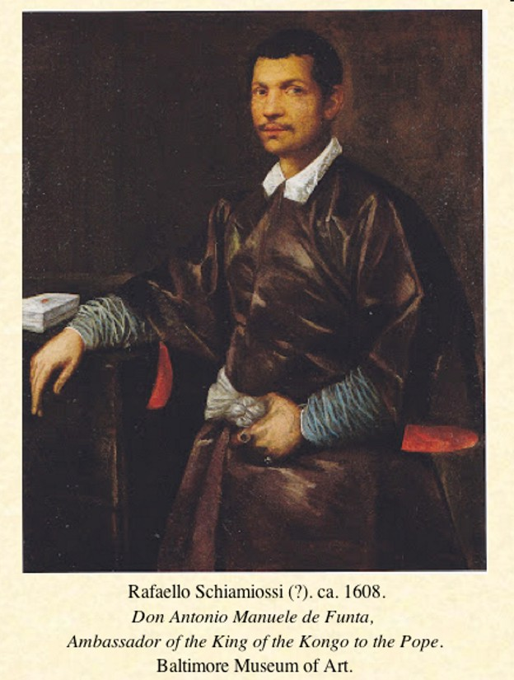
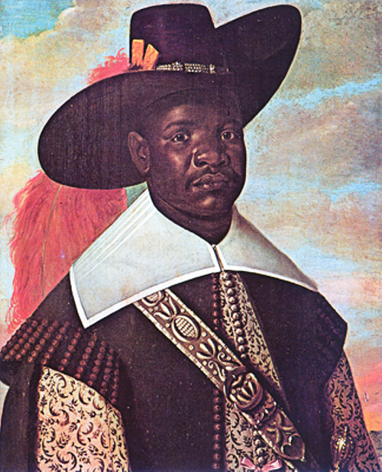

Slide 5
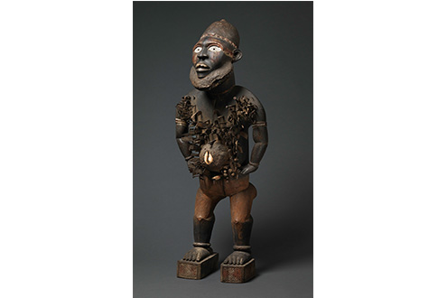
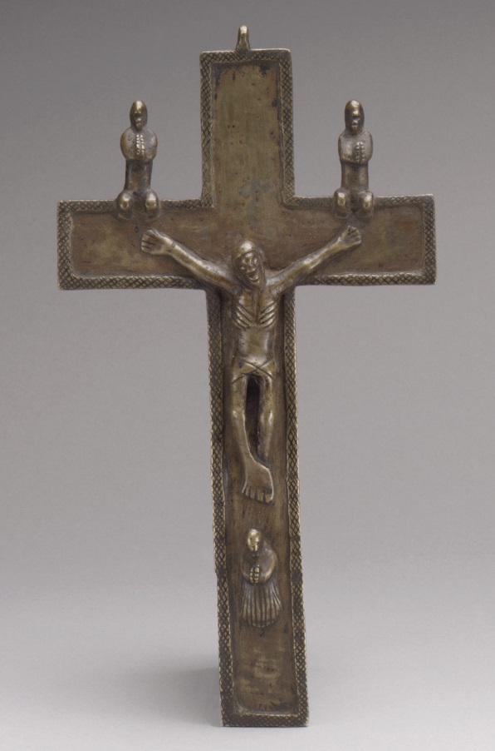
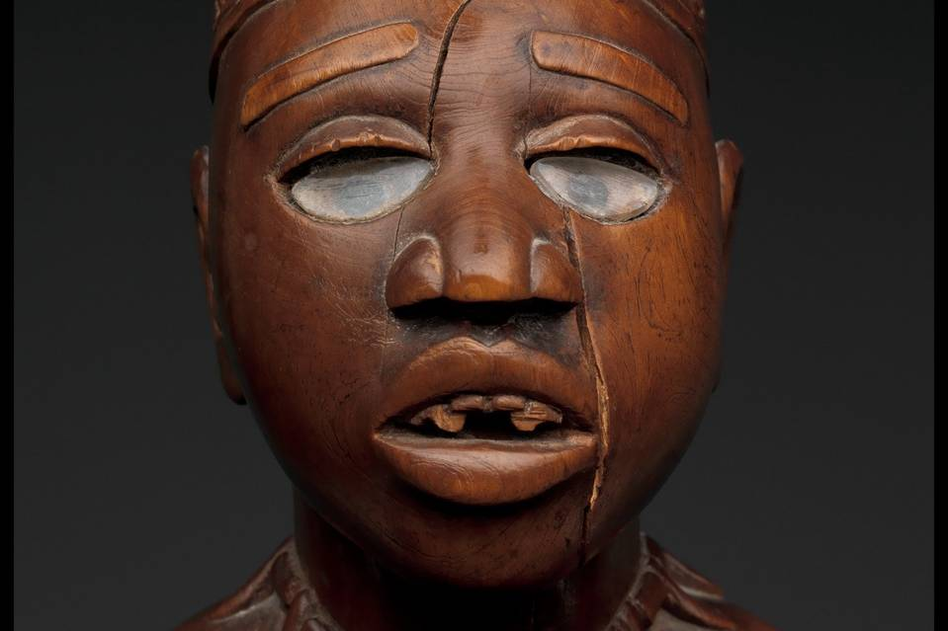

Slide 6
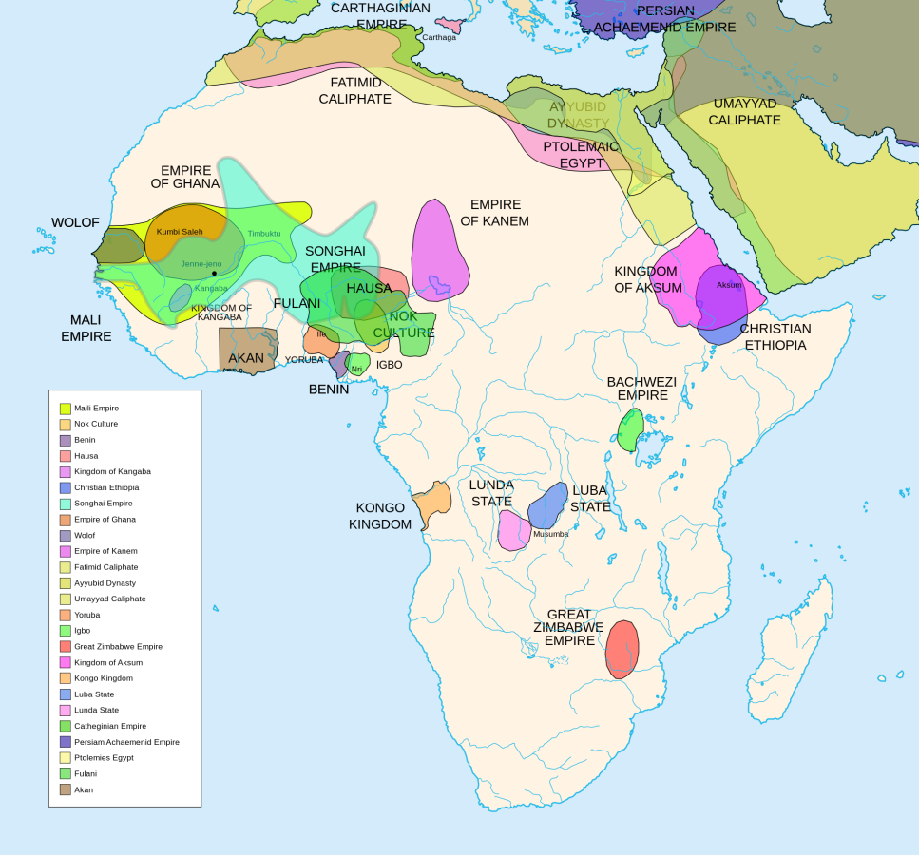
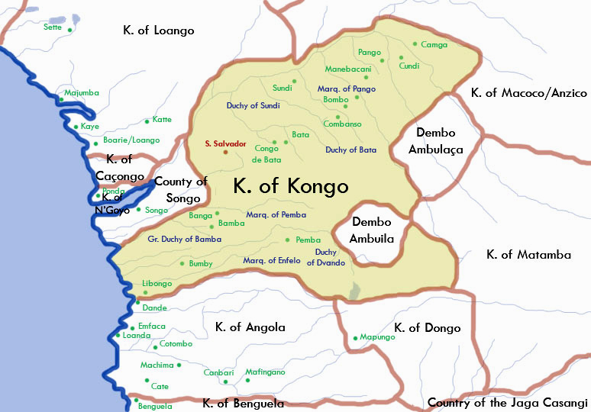
Where is the Kingdom of Kongo?

Slide 7
Some background…
The Kongo Kingdom was founded in the 14th century
It is situated in the Lower Congo and northern Angola
John Thornton – the origin of the kingdom was in the small state of Mpemba Kasi, located just south of modern day Matadi in the Democratic Republic of Congo
A dynsaty of rulers from this small state started to build up their rule
c. 1375 – the ruler of Mpemba Kasi made an alliance with the ruler of the neighbouring Mbata kingdom and, from this, the Kongo kingdom was born

Slide 8
What were the causes of the rise of the Kingdom of Kongo?
https://www.youtube.com/watch?v=tLSoaK3pY0o
Use the clip above and your pack of resources to investigate the rise of Kongo
Remember to do the following:-
List the different causes
Find evidence to support those causes
Explain how each cause contributed to the rise of Kongo
Find evidence to support these explanations
Look for links and relative importance
Find evidence to support this analysis

