Slide 1
What were the reasons for the rise of Benin?

Slide 2
Some background
Benin was one of the first kingdoms in the region of what is now Nigeria and Cameroon to have sustained contact with European traders
By 1490, the Portuguese had established a trading post at Gwaton (Ughoton)
They had ambassadors at the court of the Oba
Benin’s trade with Europeans was mainly textiles as the Obas barred the sale of male slaves

Slide 3
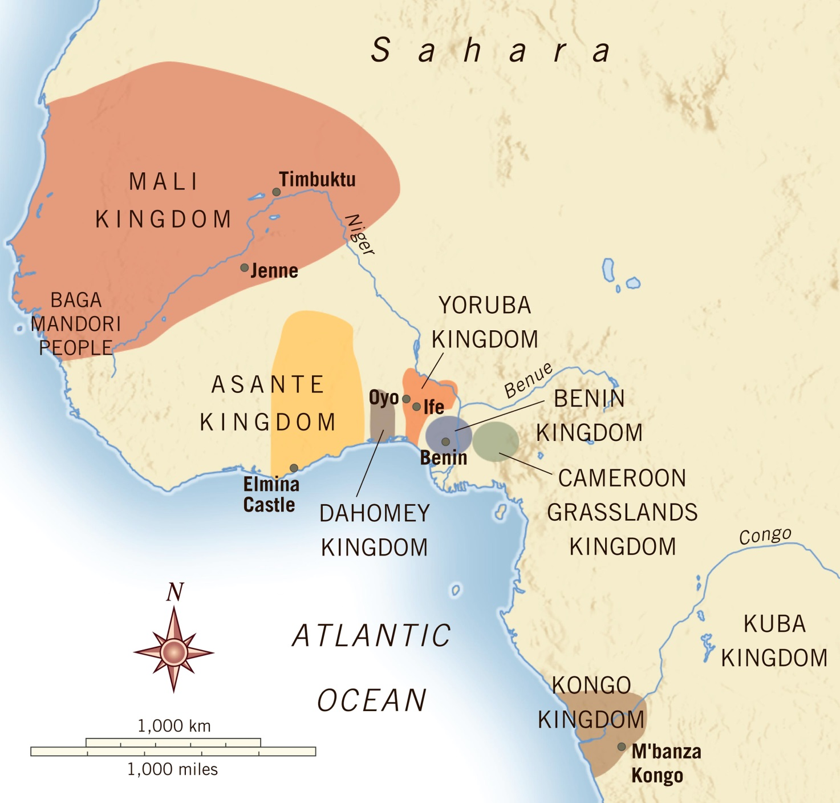

Slide 4
Changing fortunes of benin
As the Atlantic slave trade became more important after 1650, Benin’s lack of involvement made their position weaker than their neighbours
Decline set in before revitalisation under Oba Eresoyen towards 1750
By this time, slave trading had begun in the kingdom
Watch Lost Kingdoms of Africa Ep.4 and make notes on the key points identified

Slide 5
homework
Take a look at https://www.youtube.com/watch?v=TKG6Ei505GQ
Use pp.38-39 of you e-book and any other resources to make an interactive timeline showing the reasons for the rise of Benin

